Slide 1
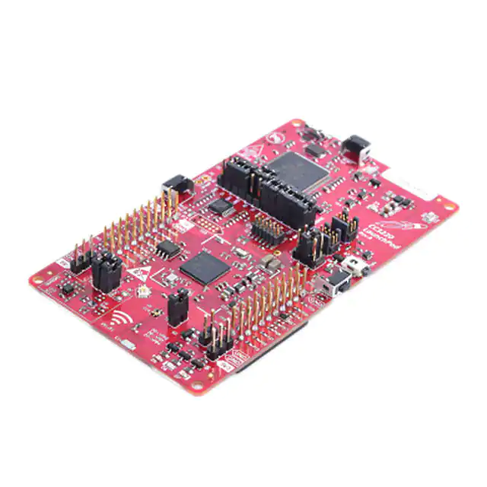
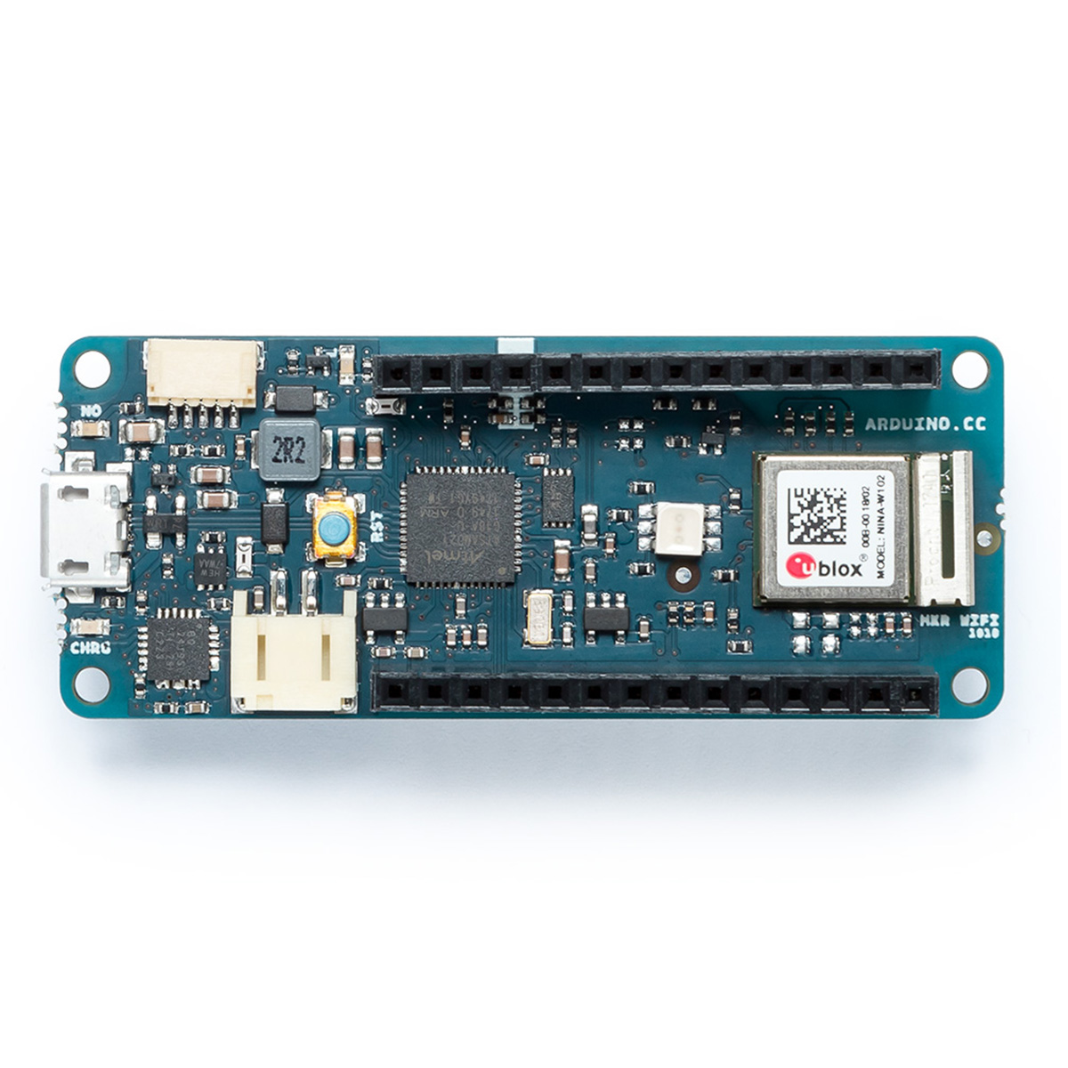
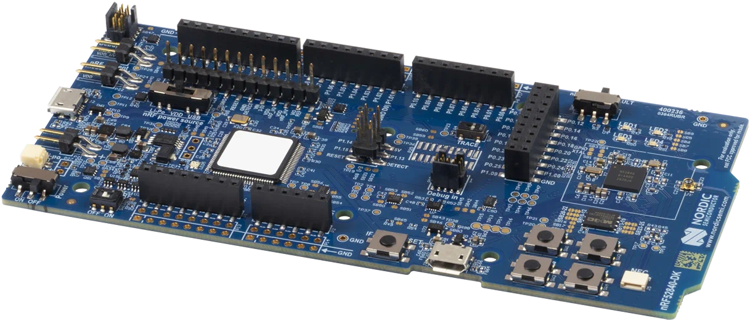
Nordic Semiconductor chip nRF52840
Texas Instruments chip
CC3220SF
Arduino MKR

